Slide 1
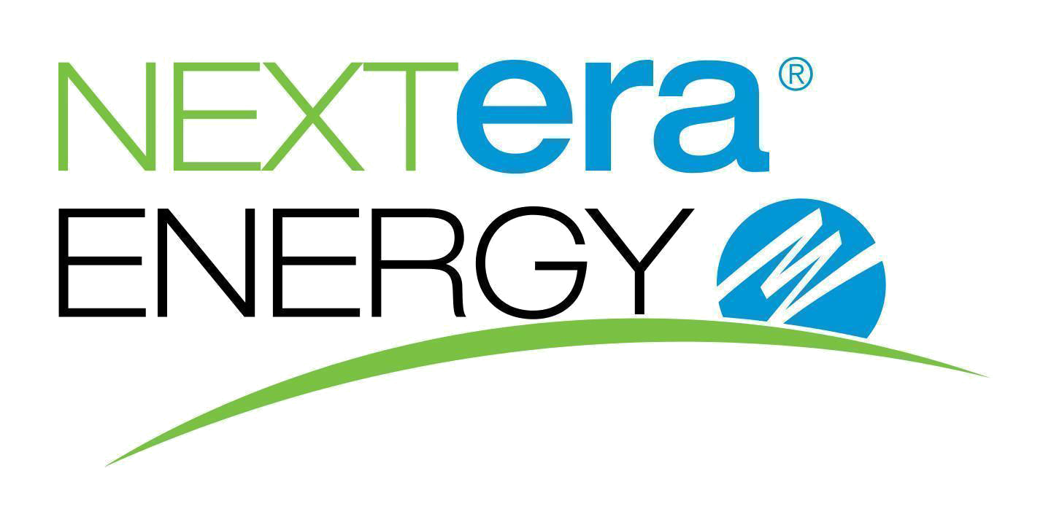

Slide 2




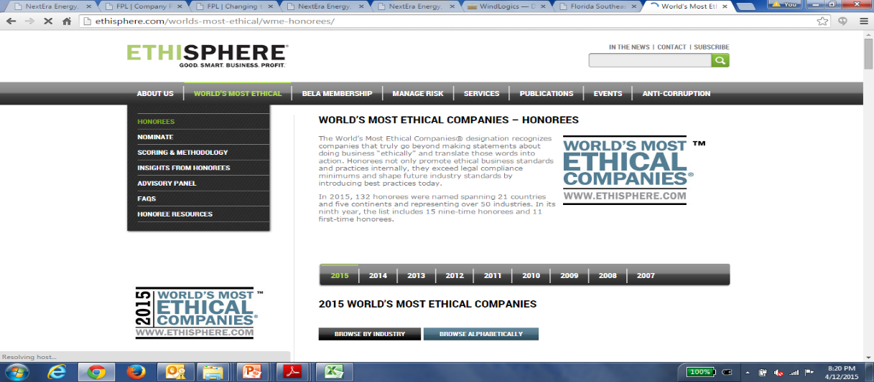




About NextEra Energy
NextEra Energy Major Subsidiaries
$16.7 B
Revenue in FY 2018
Largest Electric Utility in Florida
Largest Utility in US by Market Cap of
$113 Billion
The largest rate-regulated electric utility in Florida, serves approximately 4.9 million customer accounts in the state and has the third-largest number of customers in the United States
~ 5.5 million
Customers
Operations in 36 states in US & 4 provinces in Canada
The largest renewable energy generator in North America from the wind and sun, generates 23,970 MW of electricity in 40 states of U.S.A. and Canada
15,000+
Employees
It is a U.S. investor-owned electric utility owned by NextEra Energy, and has a service territory that spans 7,550 square miles in 10 counties and 71 towns in northwest Florida.
For the 11th year, NEE has been named one of the World's Most Ethical Companies by Ethisphere Institute
~ 49,000 MW
Generation Capacity
It is a natural gas distribution company, serving approximately 110,000 residential and commercial natural gas customers in Florida’s Miami-Dade, Brevard, St. Lucie, and Indian River counties
#1 on Fortune’s list of World’s Most Admired Company in Electric & Gas Utilities Industry
#167
Fortune 500 List
For the third consecutive year, NextEra Energy was named by Forbes as one of America's Best Employers
A leading energy solutions provider that develops, designs, and builds comprehensive energy-related solutions for federal, state and local government and business customers

